Slide 1
Java note
By ER parnanand kumar

Slide 2
Introduction
Java is a popular third-generation programming language, which can be used to do any of the thousands of things that a computer software can do.

Slide 3
Simple Java Program
/* program Helloworld.java */
public class helloWorld {
public static void main(String[] args) {
System.out.println("Hello Parnand Sir");
}
}//main ends here

Slide 4
Types of Java Programs
There are two types of Java programs
  Internet applets
  Stand alone applications.

Slide 5
Java Character Set
Character set is a set of valid characters that a language can recognise.
A character represents any letter, digit or any other sign Java uses the Unicode character set,
Unicode is a two-byte character code set that has characters representing almost all characters in almost all human alphabets and wniting systems around the world including English, Arabic, Chinese and many more
The first 128 characters in the Unicode character set are identical to the common ASCII
The second 128 characters are identical to the upper 128 characters of the Iso Latin-1 extended ASCII character set
It’s the next 65,280 characters that present problems,

Slide 6
Tokens
The smallest individual unit in a program is known as a Token.
Java has following tokens
  Keywords
  Identifiers
  Literals
  Punctuators
  Operator

Slide 7
Keywords
Keywords are the words that convey a special meaning to the language compiler.
These are reserved for special purpose and must not be used as normal identifier names
abstract default if Private this
boolean do implements protected throw
break double import public throws
byte else instanceof retum transient
case extends int short try
Catch final interface static void
char finally long strictEp volatile
Class float native super while
const for new switch
Conhinue goto package synchronized

Slide 8
Identifiers:-
Identifiers are fundamental building blocks of a program and are used as the general terminology for the names given to different parts of the program vz variables, objects, classes, functions, arrays etc
Identifier forming rules of Java state the following :
1. Identifiers can have alphabets, digits and underscore and doller sign characters
2. They must not be a keyword or boolean literal or null literal.
3. They must not begin with a digit.
4. They can be of any length
5. Java is case sensitive 1 e., upper-case letters and lower-case letters are treated differently.

Slide 9
Identifier Naming Conventions
While making identifier names, certain conventions are followed. These are .
The names of public methods and instance variables should begin with a lower case letter e.g, maximum sum
For names having multiple words, second and subsequent words beginning character is made capital so as to enhance readability e.g, avgSalaryOfEmployees, dateOfBirth
Private and local variables should use lower case letters e.g., width, result, final_score
The class names and interface names begin with an upper case letter e.g. InitialClass, Employee, Student
The constants should be named using all capital letters and underscores e.g., MAX_VALUE, MAX_MARKS, SPECIAL SALARY, TOTA

Slide 10
Literals
Literals (often referred to as constant) are data items that are fixed data value.
Java allows several kinds of literals
Integer-literal
Floating –literal
Character-literal
String-literal
Boolean-literal
The null-literal

Slide 11
(i) Integer Literals
Integer literals are whole numbers without any fractional part.
The method of writing integer constants has been specified in the following rule.
An integer constant must have at least one digit and must not contain any decimal Point.
It may contain either + or — sign.
A number with no sign is assumed to be positive Commas cannot appear in an integer constant

Slide 12
Java allows three types of integer literals
1. Decimal (base 10) 2. Octal (base 8) 3. Hexadecimal (base 16)
Decimal Integer Literals. An integer literal consisting of a sequence of digits ts taken to be decimal integer constant unless it begins with 0 (digit zero), For instance, 1234, 41, + 97, —17 are decimal integer literals.
Octal Integer Literals. A sequence of digits starting with 0 (digit zero) is taken to be an octal integer For instance, decimal integer 8 will be written as 10 as octal integer (810=108)
Hexadecimal Integer Literals. A sequence of digits preceded by 0x or 0X is taken to be an hexadecimal integer. For instance, decimal 12 will be written as 0XC as hexadecimal integer. But with Hexadecimal constants only 0-9 and A-F can be used.

Slide 13
(ii) Floating Literals
Floating literals are also called real literals.
Real literals are numbers having fractional parts .These may be written in one of the two forms called fractional form or the exponent form.
A real literal in fraction form consists of signed or unsigned digits including a decimal point between digits.
The rule for writing a real constant in fractional form is given below :
  A real literal in fractional form must have at least one digit before a decimal point and at least one digit after the decimal point.
  It may also have either + or - sign preceding it.
  A literal with no sign 1s assumed to be positive.

Slide 14
(iv) Boolean Literals
The boolean type has two values, represented by the literals true and false, formed from ASCII letters.
A boolean literal is always of type boolean. It is either boolean value true or boolean value false.

Slide 15
(iv) Character Literals
A character literal is one character enclosed in single quotes, as in ‘z’.
The rule for writing character constant is given below :
  A character literal in Java must contain one character and must be enclosed in single quotation marks.
java allows you to have certain nongraphic characters in character constants .
Nongraphic character are those characters that connot be typed directly from keyboard.
  Eg backspace, tabs, carriage return e.t.c
Those non-graphic characters can be represented by using escape sequence.
An escape sequence is represented by a backslash (\) followed by on or more characters.

Slide 16
listing of escape sequences -
Escape Sequence Nongraphic Character —__
\a Audible bell (alert)
\b Backspace
\f Formfeed
\n Newline or linefeed
\r Carnage Return
\t Horizontal tab
\v Vertical tab
\\ Backslash
\’ Single quote
\” Double quote
\? Question mark
\On Octal number (On represents the number in octal)
\xHn Hexadecimal number (Hn represents the number in hexadecimal)
\uHn Unicode character represented through its hexadecimal code Hn
\0 Null

Slide 17
(v) String Literals
‘Multiple Character’ constants are treated as string-literals.
The rule for writing string-literal given below :
A string literallis a sequence of Zero or more characters surrounded by double quotes.
Each character may be represented by an escape sequence,
  "abc” size 6 bytes (each character takes 2 bytes)
  "\ab“ size 4 bytes ( \a is one character)

Slide 18
(vi) The Null Literal
The null type has one value, the null reference, represented by the literal null, which is formed from ASCII characters. A null literal is always of the null type

Slide 19
Separators
The following nine ASCII characters are the separators (punctuators) .
() {} []
Operators
The following 37 tokens are the operators, formed from ASCII characters
= | > | <

Slide 20
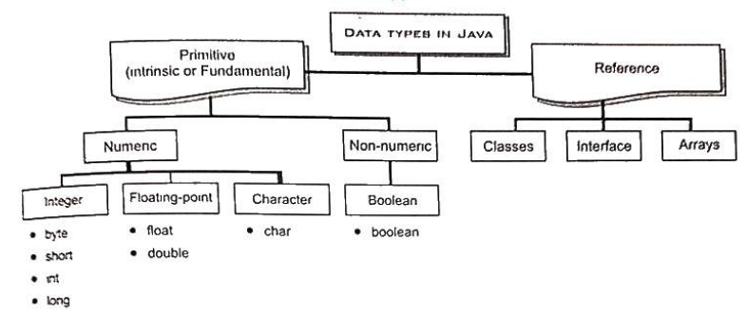
Data Types
Data types are means to identify the type of data and associated operations of handling it

Slide 21
Java data types are of two types
Primitive(or intrinsic) data types
  Primitive datatypes come as a parts of the language. Java provides eight primitive datatypes, Which are : byte, short, int, long, float, double, char, boolean
Reference data types
  Reference datatypes are constructed from primitive data types. These are : classes, arrays and interface. But their storage mechanism is different from primitive datatypes.

Slide 22
Primitive Datatypes
Primitives are the "basic" data values. The word ‘Primitive means a fundamental component that may be used to create other larger parts.
Java supports following four categories of primitive datatypes .
  Numeric Integral primitive types
  Fractional primitive types
  Character primitive types
  Boolean primitive types

Slide 23
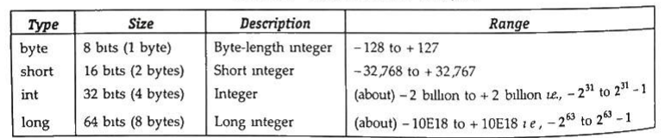
Numeric Integral Types
The datatypes that are used to store numeric values fall under this sub category i.e numeric primitive datatypes.
There are four numeric integral types in Java
byte
Short
int
long

Slide 24
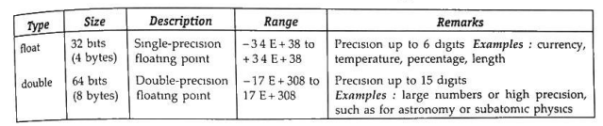
Fractional Numeric Types
Fractional datatypes can store fractional numbers 1.e., numbers having decimal points. These are also called floating-point datatypes

Slide 25
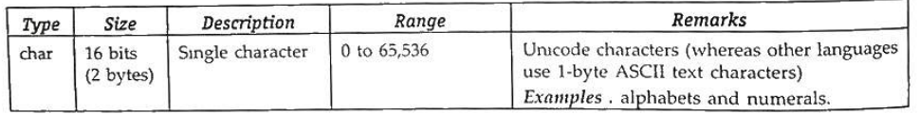
Character Types
The character datatype - char datatype of Java is used to store characters

Slide 26
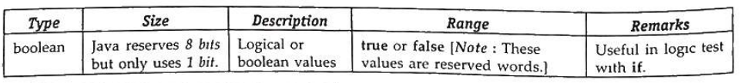
(iv) Boolean Type
Another of the primitive datatypes 1s the type boolean. It is used to represent a single true/false value.
A boolean value can have only one of two values : true or false

Slide 27
Reference Datatypes
Broadly a reference in Java is a data element whose value 1s an address Arrays, classes, and interfaces are reference types
The value of a reference type variable, in contrast to that of a primitive type, is a reference to (an address of) the value or set of values represented by the variable (Fig 5.1)

Slide 29
Variables
Varibles represent named storage locations, whose values can be manipulated during program run .
A variable is a named memory location, which holds a data value of a particular data type.
Declaration of a Variable
The declaration of a variable generally takes the following form
type variable name

Slide 30
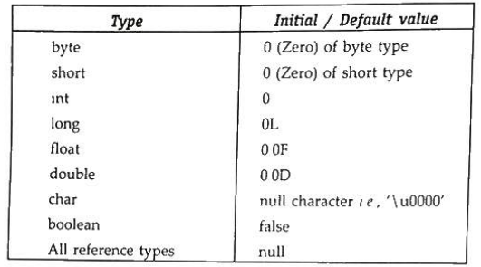
Initial Values of Variables

Slide 31
Constants
The keyword final makes a variable as constant i.e., whose value can not be changed during Program execution.

Slide 32
Operators in Java
The operations (specific tasks) are represented by operators and the objects of the operations(s) are referred to as operands
Types of Operators in Java
  Arithmetic Operators
  Unary Operators
  Assignment Operator
  Relational Operators
  Logical Operators
  Ternary Operator
  Bitwise Operators
  Shift Operators
  instance of operator

Slide 33
Arithmetic Operators
Java provides operators for five basic arithmetic calculations : addition, subtraction, multiplication, division and remainder which are +,-,%, / and % respectively
Each of these operators is a binary operator t.e., it requires two values (operands) to calculate a final answer.

Slide 34
Unary Operators
Java provides two unary arithmetic operators (that require one operand) also which are unary +, and unary -.
1.Unary +
  The operator unary “+” precedes an operand
    ifa=5 then +a means 5,
    if a= 0 then +a means 0,
    if a = -4 then +a means — 4.
2. Unary –
  The operator unary - precedes an operand.
    if a=5 then -a means — 5.
    if a= 0 then -a means 0 (there 15 no quantity known as ~ @)
    if a =-4 then -a means 4.

Slide 35
Binary Operators
Operators that act upon two operands are referred to as Binary Operators.
1. Addition operator +
The arithmetic bnary operator + adds values of its operands and the result is the sum of the values of its two operands For example,
  4+ 26 results in 24,
  a+5 (where a = 2) results in 7,
  a+b (where a = 4, b = 6) results in 10,
2. Subtraction operator -
The - operator subtracts the second operand from the first For example,
  14 - 3 evaluates to i1
  a-b (where a= 7, b= 5) evaluates to 2,

Slide 36
3. Multiplication operator *
The operator multiplies the values of its operands. For example,
  b* 4 (where b = 6) evaluates to 24.
  a*c {where a= 3, C= 5) evaluates to 15:
  3 * 4 evaluates to 12
4. Division operator /
The / operator divides its first operand by the second, For example
    1008/5 evaluates to 26.
    a/2 (a = 16) evaluates to 8.
    a/b (a = 15.9, b = 3) evaluates to 5.3.
5. Modulus operator %.
The % operator finds the modulus of its first operand relative to the
second.
    19 % 6 evaluates to 1, since 6 goes into 19 three times with a remainder 1.

Slide 37
Increment/Decrement Operators (++, -- )
++ : Increment operator, used for incrementing the value by 1. There are two varieties of increment operators.
Post-Increment: Value is first used for computing the result and then incremented.
Pre-Increment: Value is incremented first, and then the result is computed.
– – : Decrement operator, used for decrementing the value by 1. There are two varieties of decrement operators.
Post-decrement: Value is first used for computing the result and then decremented.
Pre-Decrement: The value is decremented first, and then the result is computed.
! : Logical not operator, used for inverting a boolean value

Slide 38
Relational Operators
==, Equal to returns true if the left-hand side is equal to the right-hand side.
!=, Not Equal to returns true if the left-hand side is not equal to the right-hand side.
<, less than: returns true if the left-hand side is less than the right-hand side.
<=, less than or equal to returns true if the left-hand side is less than or equal to the right-hand side.
>, Greater than: returns true if the left-hand side is greater than the right-hand side.
>=, Greater than or equal to returns true if the left-hand side is greater than or equal to the right-hand side.

Slide 39
Logical Operators
&&, Logical AND: returns true when both conditions are true.
||, Logical OR: returns true if at least one condition is true.
!, Logical NOT: returns true when a condition is false and vice-versa

Slide 40
Shift Operators
<<, Left shift operator: shifts the bits of the number to the left and fills 0 on voids left as a result. Similar effect as multiplying the number with some power of two.
>>, Signed Right shift operator: shifts the bits of the number to the right and fills 0 on voids left as a result. The leftmost bit depends on the sign of the initial number. Similar effect to dividing the number with some power of two.
>>>, Unsigned Right shift operator: shifts the bits of the number to the right and fills 0 on voids left as a result. The leftmost bit is set to 0.

Slide 41
Bitwise Operators
&, Bitwise AND operator: returns bit by bit AND of input values.
|, Bitwise OR operator: returns bit by bit OR of input values.
^, Bitwise XOR operator: returns bit-by-bit XOR of input values.
~, Bitwise Complement Operator: This is a unary operator which returns the one’s complement representation of the input value, i.e., with all bits inverted.

Slide 42
Ternary operator
The ternary operator is a shorthand version of the if-else statement. It has three operands and hence the name Ternary.
The general format is:
condition ? if true : if false
The above statement means that if the condition evaluates to true, then execute the statements after the ‘?’ else execute the statements after the ‘:’.

Slide 43
Assignment Operator
‘=’ Assignment operator is used to assign a value to any variable. It has right-to-left associativity, i.e. value given on the right-hand side of the operator is assigned to the variable on the left, and therefore right-hand side value must be declared before using it or should be a constant.
The general format of the assignment operator is:
variable = value;
In many cases, the assignment operator can be combined with other operators to build a shorter version of the statement called a Compound Statement. For example, instead of a = a+5, we can write a += 5.
+=, for adding the left operand with the right operand and then assigning it to the variable on the left.
-=, for subtracting the right operand from the left operand and then assigning it to the variable on the left.
*=, for multiplying the left operand with the right operand and then assigning it to the variable on the left.
/=, for dividing the left operand by the right operand and then assigning it to the variable on the left.
%=, for assigning the modulo of the left operand by the right operand and then assigning it to the variable on the left

Slide 44
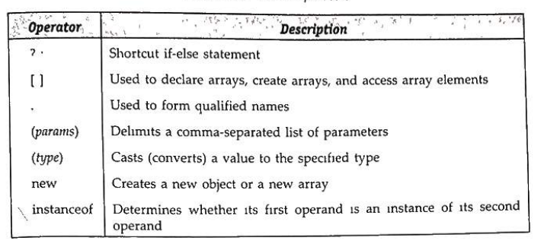
Other Operators

Slide 45
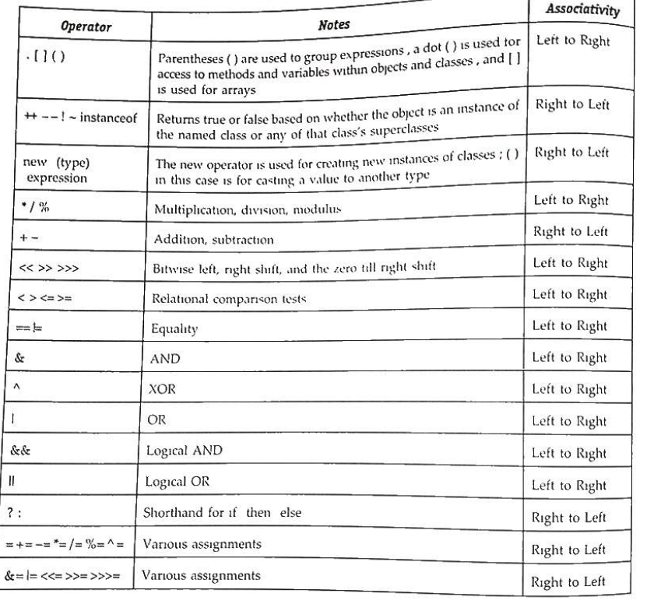
operator
Precedence

Slide 46
Expressions

Slide 47
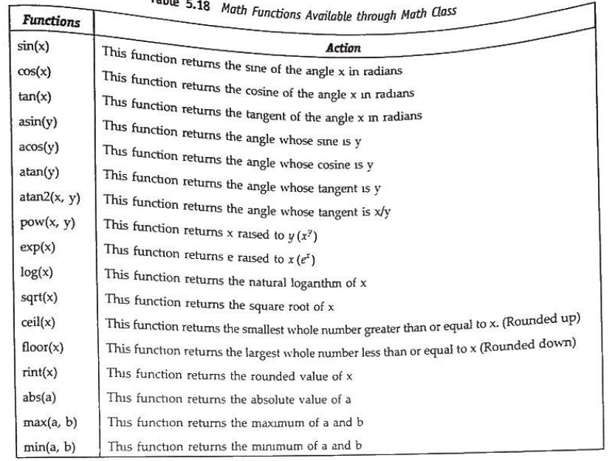
Math function available through math class

Slide 48
Type Conversion
The process of converting one predefined type into another is called type conversion.
When constants and variables of different types are mixed in an expression , they are converted to the same type.
Java provides two type of conversion:
  Implicit type conversion
  Explicit type conversion

Slide 49
i) Implicit type conversion
An implicit type conversion is a conversion performed by the compiler without programmer’s intervention.
The Java compiler converts all operands upto the type of the largest operand, which is called type promotion.
This is done operation by operation, as described in the following type conversion rules .
  If either operand is of type double, the other is converted to double.
  ® Otherwise, if either operand is of type float, the other is converted to float
  ® Otherwise, if either operand 1s of type long, the other is converted to long.
  ® Otherwise, both operands are converted to type int

Slide 50
(ii) Explicit type conversion
The explicit conversion of an operand to a specific type is called typecasting.
An explicit type conversion is user-defined that forces an expression to be of specific type.
Type casting in java is done as show below
  (type) expression
Eg
Y = (float)(x+y/2)

Slide 51
Flow of control
A programming language uses control statements to control the flow of execution of a program based on certain conditions
Java’s Selection statements:
  if
  if-else
  nested-if
  if-else-if
  switch-case
  jump – break, continue, return

Slide 52
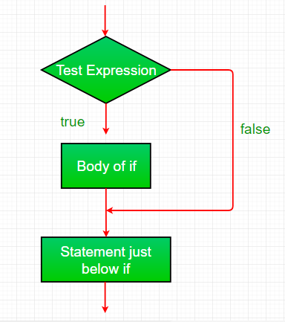
if
It is used to decide whether a certain statement or block of statements will be executed or not i.e if a certain condition is true then a block of statements is executed otherwise not.
Syntax:
  if(condition)
  {
  // Statements to execute if
  // condition is true
  }

Slide 53
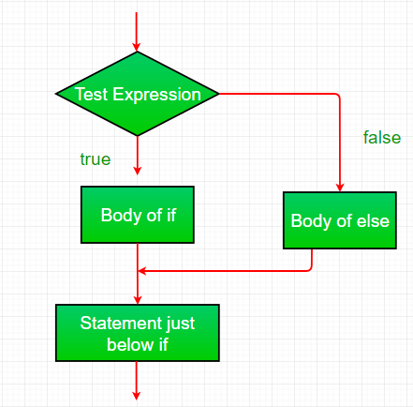
if-else:
if (condition)
{
// Executes this block if
// condition is true
}
else
{
// Executes this block if
// condition is false
}

Slide 54
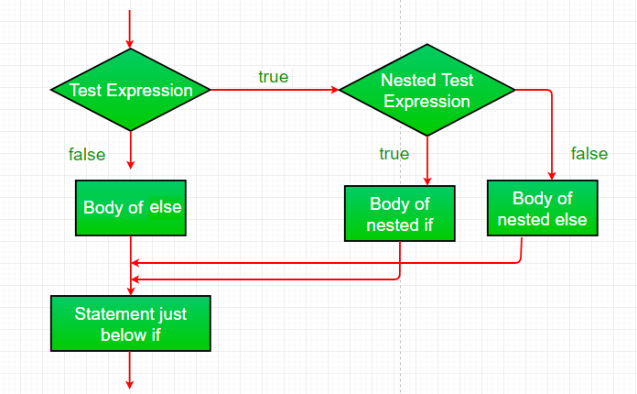
nested-if
if (condition1)
{
// Executes when condition1 is true
if (condition2)
{
// Executes when condition2 is true
}
}

Slide 55
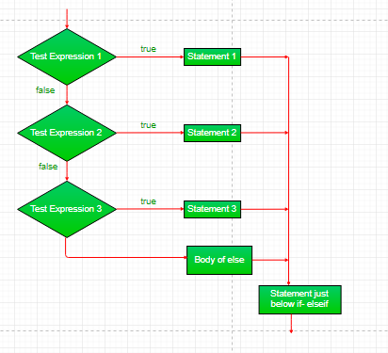
if-else-if ladder
if (condition)
statement;
else if (condition)
statement;
.
.
else
statement;

Slide 56
switch-case
switch (expression)
{
case value1:
statement1;
break;
case value2:
statement2;
break;
.
.
case valueN:
statementN;
break;
default:
statementDefault;
}

Slide 57
jump
Java supports three jump statements: break, continue and return. These three statements transfer control to another part of the program.
Break: In Java, a break is majorly used for:
  Terminate a sequence in a switch statement (discussed above).
  To exit a loop.
  Used as a “civilized” form of goto.

Slide 58
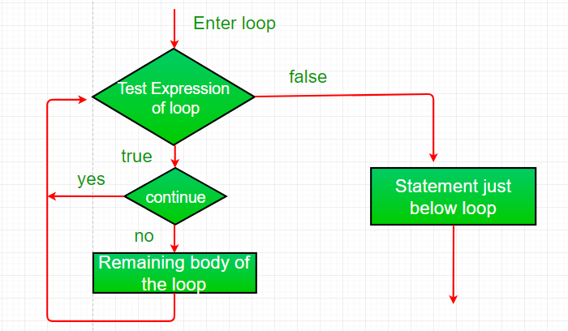
Continue:
ometimes it is useful to force an early iteration of a loop. That is, you might want to continue running the loop but stop processing the remainder of the code in its body for this particular iteration. This is, in effect, a goto just past the body of the loop, to the loop’s end. The continue statement performs such an action
// Java program to illustrate using
// continue in an if statement
import java.util.*;
class ContinueDemo {
public static void main(String args[])
{
for (int i = 0; i < 10; i++) {
// If the number is even
// skip and continue
if (i % 2 == 0)
continue;
// If number is odd, print it
System.out.print(i + " ");
}
}
}

Slide 59
Return:
The return statement is used to explicitly return from a method. That is, it causes program control to transfer back to the caller of the method.
// Java program to illustrate using return
import java.util.*;
public class Return {
public static void main(String args[])
{
boolean t = true;
System.out.println("Before the return.");
if (t)
return;
// Compiler will bypass every statement
// after return
System.out.println("This won't execute.");
}
}

Slide 60
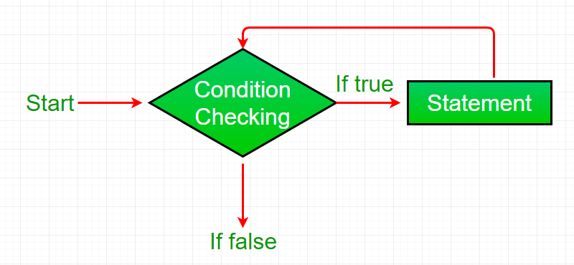
while loop:
A while loop is a control flow statement that allows code to be executed repeatedly based on a given Boolean condition. The while loop can be thought of as a repeating if statement.
Syntax :
while (boolean condition) { loop statements... }

Slide 61
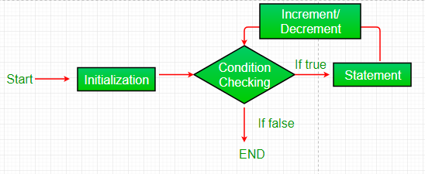
for loop
Syntax:
for (initialization condition; testing condition;increment/decrement)
{ statement(s) }

Slide 62
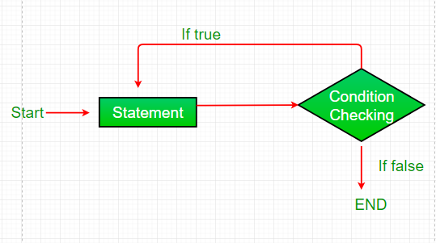
do while:
do while loop is similar to while loop with only difference that it checks for condition after executing the statements, and therefore is an example of Exit Control Loop.
Syntax:
do { statements.. } while (condition);

Slide 63

The for Loop Variations
Multiple initialization and update expressions
  for (i= 1, sum=0;sum +=i;++i) ;
  System.out.println( i ) ;
Optional expressions
  for( ; test-expression ; update-expressions(s)
  Sysytem.out.print(i);

Slide 64
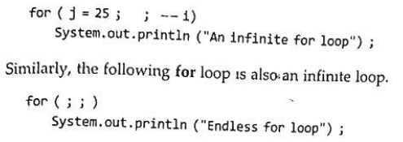
The for Loop Variations
Infinite loop
  An infinite for loop can be created by omitting the text-expression as shown below:
Empty loop
  f a loop does not contain any statement in its loop-body, it is said to be an empty loop. In such cases, a Java loop contains an empty statement 1 e., a null statement Following for loop is an empty loop –
  for (j= 20; (J >=6);--j);
Declaration of variables inside loop and if
A variable declared within an if or for / while / do-while statement cannot be accessed after the statement is over.

Slide 65
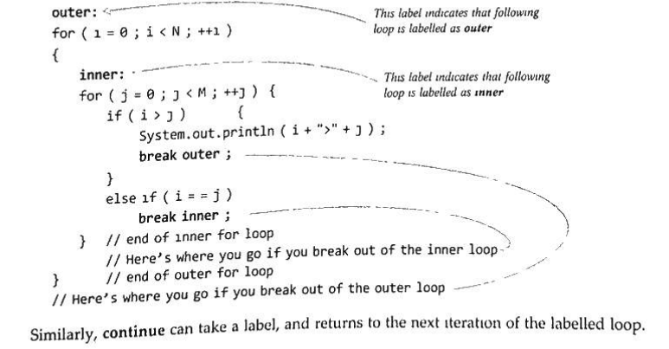
Labels and Branching Statements
The break and continue statements can also be used with labels. Let us learn about labels and labelled jump statements.

Slide 66
Labels
As you can see in above example code, statements can be labelled . Labels are typically used on blocks and loops. Labelled blocks are useful with break and continue.
The syntax for labelling a statement is :
  label: statement

